Slide 1
Autoencoders and GANs
Tim Smith, PhD

Slide 2
Autoencoders
Unsupervised learning technique
Can learn “data representation”
“latent representation”
“coding”
Sometimes, used for dimension reduction

Slide 3
“Data Representation”???
Data representation ≈ patterns
Can you identify any “patterns”?
Bedrooms | Baths | Garage (cars)
3 | 3 | 3
2 | 2 | 2
3 | 1 | 1
2 | 1 | 1
4 | 4 | 4
4 | 1 | 1
Each row represents one house

Slide 4
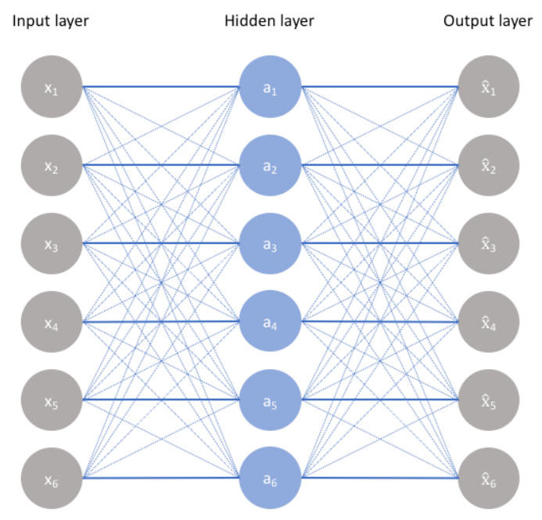
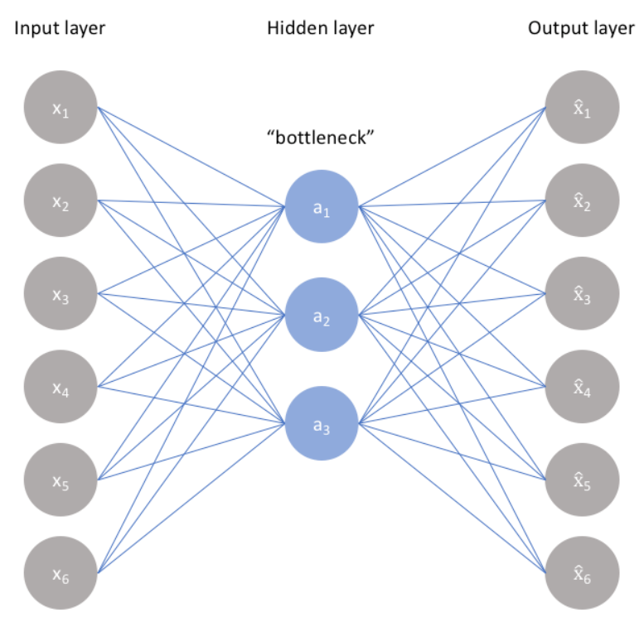
How do Autoencoders work?
Learns how to “reconstruct” the inputs (i.e., columns/features) using a neural network
Prevent “cheating” by creating a bottleneck in the network
Minimize the “reconstruction error” at the output layer
Enables “cheating”

Slide 5
What is it?
Encoder
Decoder
C
O
D
E
Input
Output
The encoder accepts input and learns how to compress and encode the data efficiently.
The decoder learns how to reconstruct the encoded data representation and creates the output.
The usefulness of this is not about the compression of an image!

Slide 6
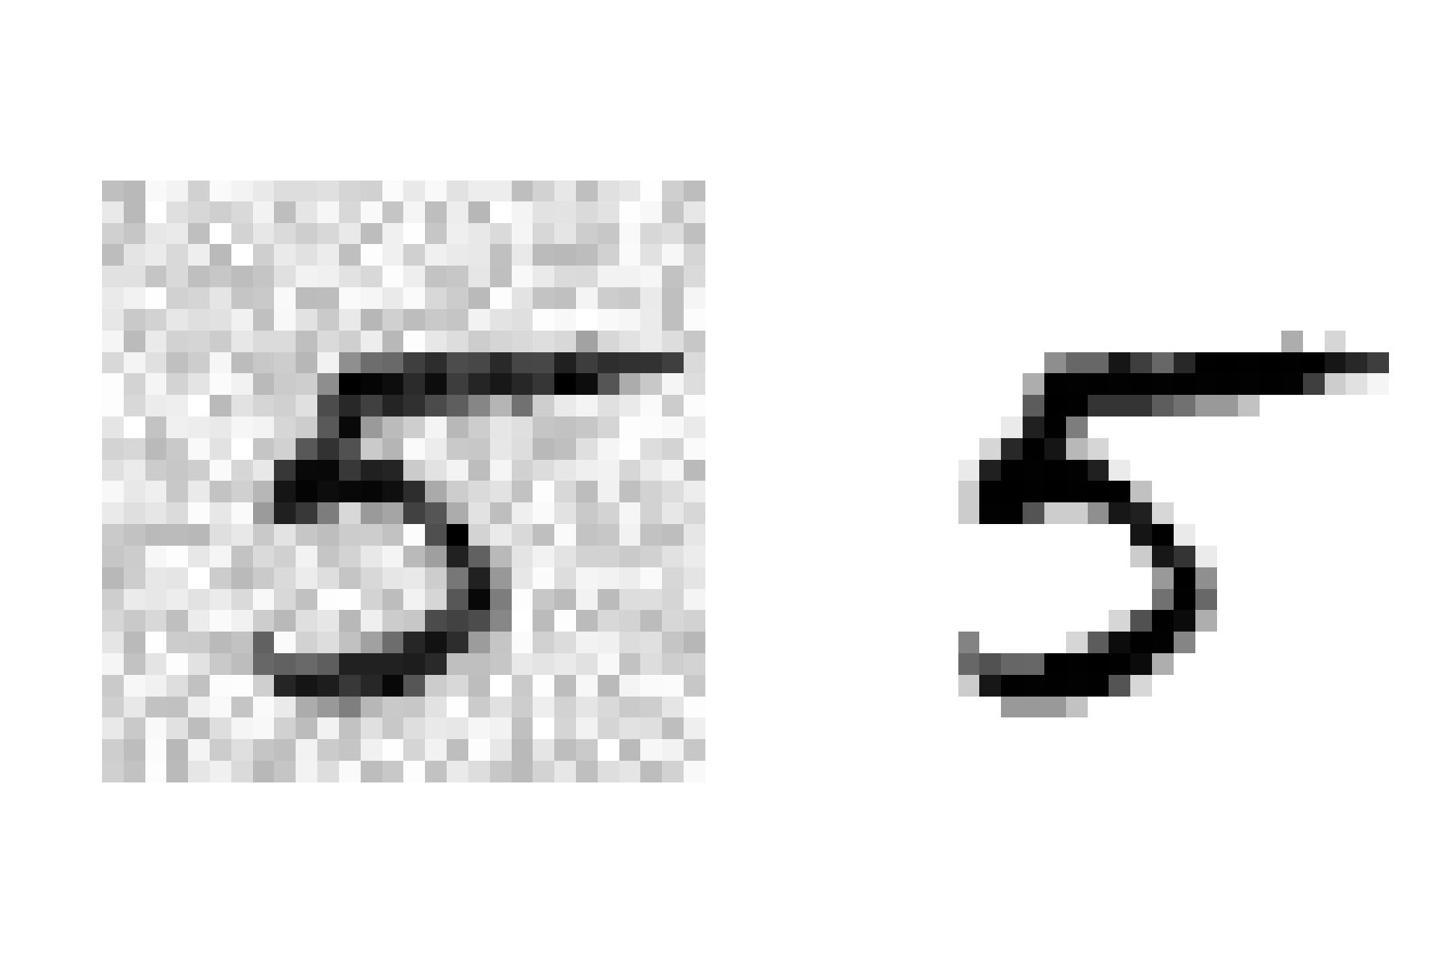
There are many uses… for example…
Encoder
Decoder
C
O
D
E
Input
Output
Identify that this is a ‘5’
Recreate a digit ‘5’
De-Noise an Image

Slide 7
There are many uses… for example…
Encoder
Decoder
C
O
D
E
Input
Output
5
Identify that this is a ‘5’
Recreate a digit ‘5’
Create a higher-resolution version of the image

Slide 8
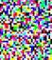
There are many uses… for example…
Encoder
Decoder
C
O
D
E
Input
Output
1
Since the autoencoder has been trained with the digits 1 through 5, it recreates the number well (though it isn’t exactly the same image). Therefore, there is low error between the input and output.
1
3
3
5
2
5
2
4
4
Since the image of a cat is completely new, it’s an anomaly. Therefore the autoencoder recreates something very different than a cat. Therefore, there is HIGH error between the input and output.
🐈‍⬛

Slide 9
Why use Autoencoders?
Anomaly (outlier) detection
Value imputation
Image enhancement
Identifying special cases that need to be trained on

Slide 10
Usually, much of the incoming data is “normal”
By normal, we mean that the autoencoder has seen similar patterns before.
Train the autoencoder
Learns the “normal” data representation
Reconstruction error is small
Send the anomalous data
Doesn’t know how to reconstruct the data
Reconstruction error is LARGE

Slide 11
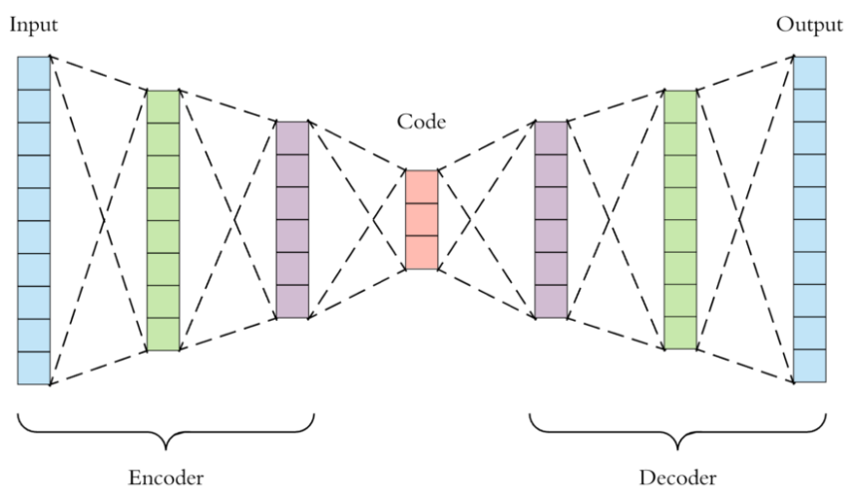
Autoencoders
Implemented as a neural network with multiple layers…
N inputs
N outputs
Latent representation

Slide 12
Autoencoders
Performs principal component analysis (PCA) IF:
Uses linear activation functions
Cost function is Mean Squared Error
Principal components

Slide 13
Stacked (Deep) Autoencoders
More than one hidden layer
Be careful:
Don’t make it too powerful
It will learn to create each input individually (Overfitting)
We want to force the model to generalize, not fit perfectly
By forcing the data through a skinny layer, the model must attempt to ‘generalize’ the representation and find relevant patterns that can simplify the data representation.
We refer to this layer as the ‘bottleneck’ layer
Input layer
Output layer

Slide 14
Stacked (Deep) Autoencoders
How to configure the layers?
If input variables are binary:
Inner layers: use non-linear activation functions (selu, relu)
Output layer: use sigmoid activation function
Coverts the outputs to values between 0 and 1
Output layer: use binary_crossentropy as the loss function (treat it as classification)
If input variables are continuous:
Inner layers: use non-linear activation functions (selu, relu)
Output layer: do NOT use an activation function (it will use a linear function)
Output layer: use mean_squared_error as the loss function (treat it as regression)

Slide 15
Autoencoders: Unsupervised Pretraining
Another use for autoencoders (useful for images)
What if you have very few labeled data (for supervised learning)?
Bedrooms | Baths | Garage (cars)
3 | 3 | 3
2 | 2 | 2
3 | 1 | 1
2 | 1 | 1
4 | 4 | 4
4 | 1 | 1
unlabeled
“Single-family”
unlabeled
“Condo”
unlabeled
unlabeled

Slide 16
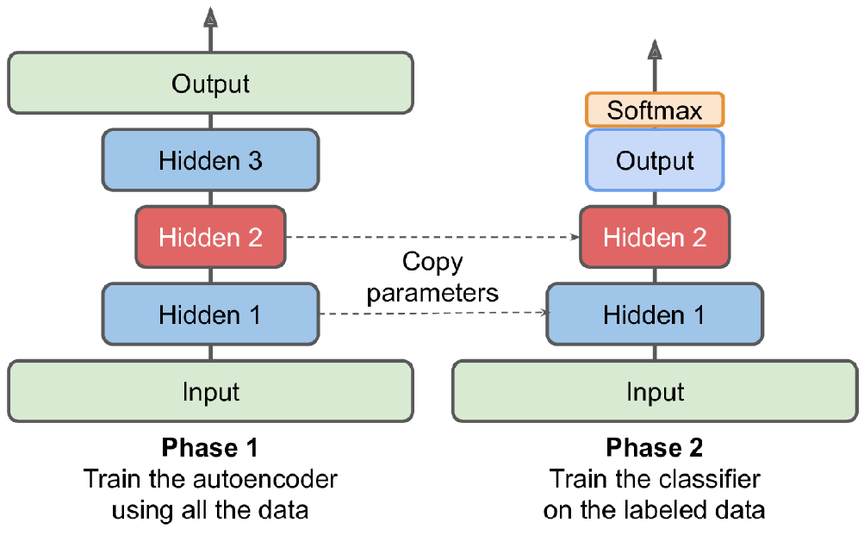
Autoencoders: Unsupervised Pretraining
Learn the pattern using the autoencoder
Copy the layers and FREEZE them
Train the output layer on the few labeled data
Perform predictions!

Slide 17
No just for regular Feed-Forward fully connected networks…
'Regular’ Neural Networks
RNN/LSTM/GRU/Conv1D
Learns the data representation in time-series data
Can detect anomalies that require more attention
Convolutional Neural networks
Can process images
De-Noise
Expand

Slide 18
Summary
Autoencoders
Unsupervised
Learns data representation
Must be forces to ‘generalize’ a representation of the data
Create a ‘narrow’ layer between the encoder/decoder

